Slide 1

A Journey of Leadership

Slide 2
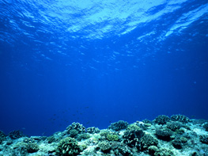
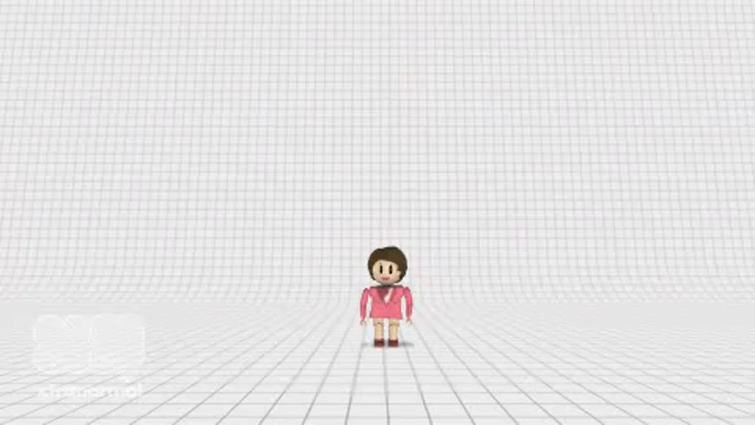

Slide 3


Seashell Isle – experiences that shaped me
Starfish Cove – most valuable leadership
St. Rocks – the past meets the future
Seagrass Island – lessons learned
Sandy Beach – moving forward…

Slide 4









Sea Shell Isle

Slide 5
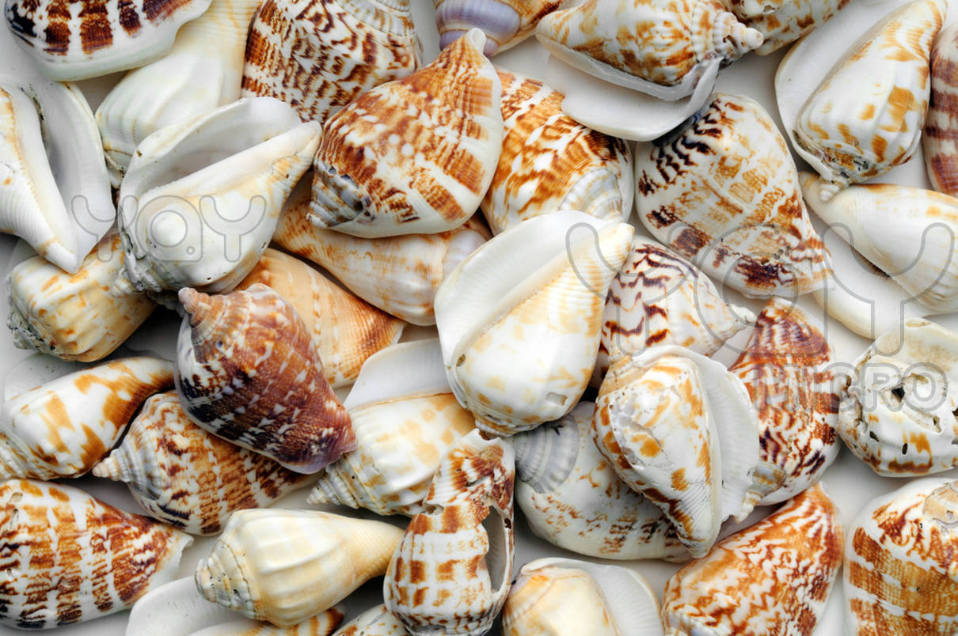

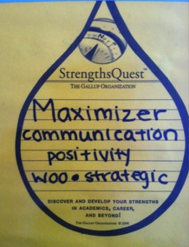
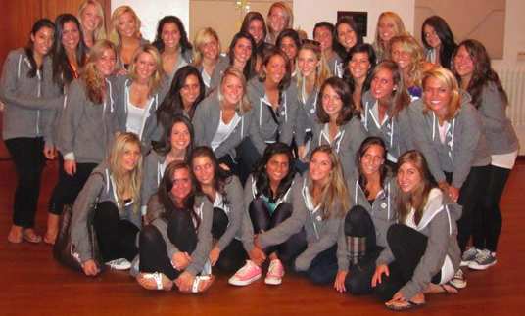
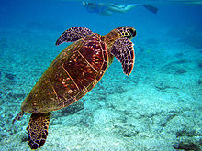
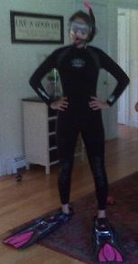

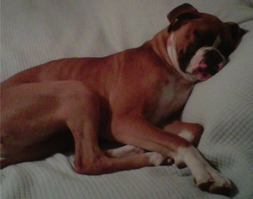
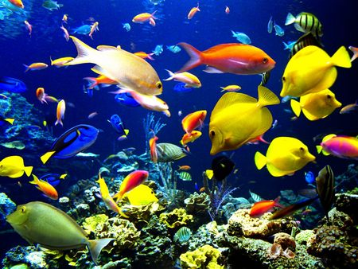

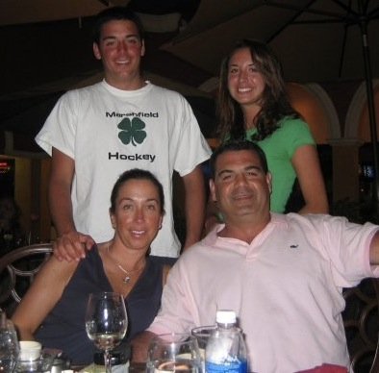
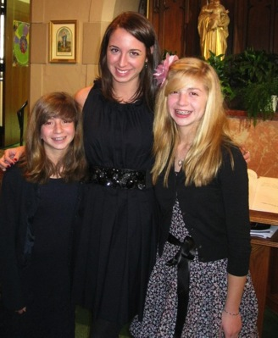
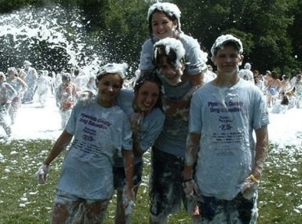

Notes:
8.
Student will express a personal values statement

Slide 6
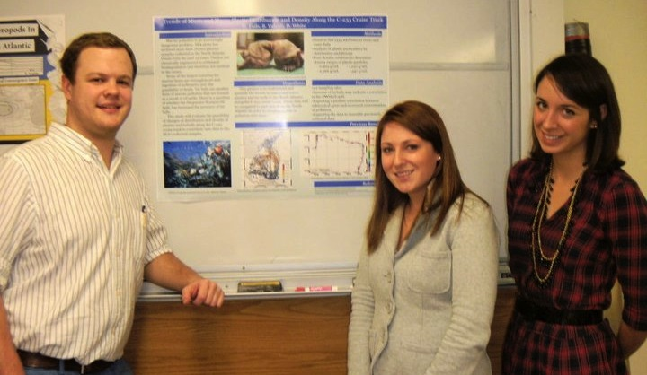
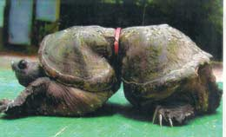
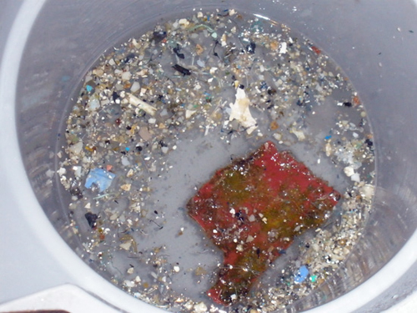
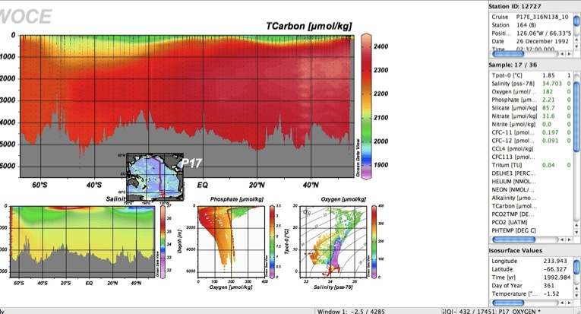
Trends of Micro and Macro Plastic Distribution and Density Along the C-233 Cruise Track
Notes:
97. Student will describe personal examples of group dynamics and group roles
98. Student will show knowledge of effective memberships skills in groups → COMMUNICATION

Slide 7
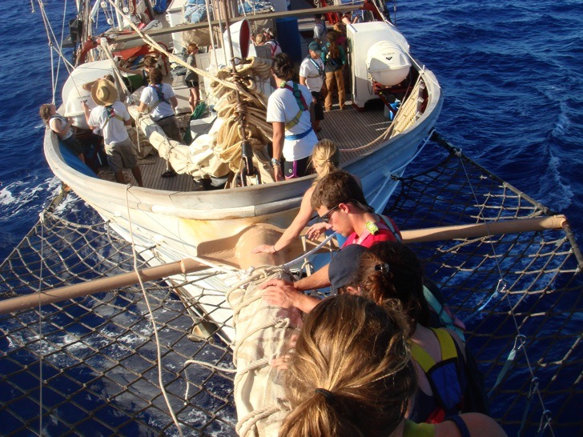
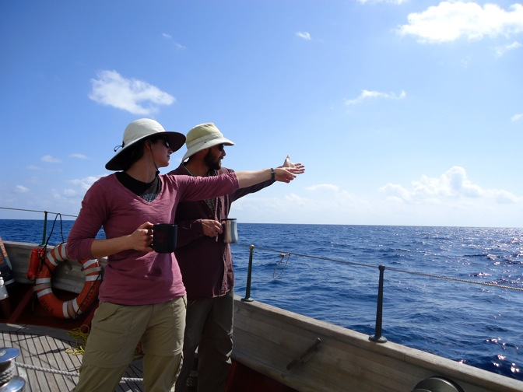
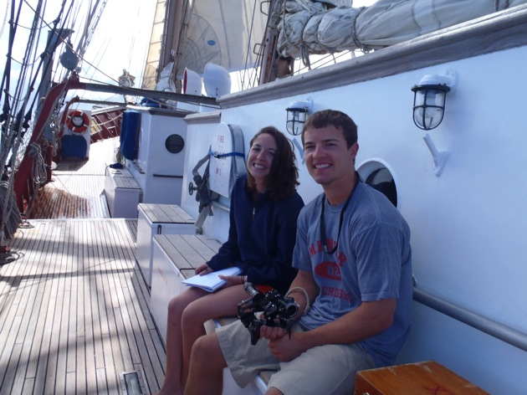
Decision Making Model
Diagnose the situation
Select appropriate style for the situation…
OBSERVING – autocratic
Notes:
78. Student will show knowledge of at least five decision making methods
BUS 441 – decision making model – step one – DIAGNOSE THE SITUATION
step two – SELECT APPROPRIATE STYLE FOR THE SITUATION
…first third – autocratic – scientist or mate would make decision without consulting us
…second third – participative– sci or mate would present the problem to the group for
suggestions, also literally explained everything they did because..
…third third – consultation – but, WE were the sci or mate, and the real one wouldn’t help at
all, we had to rely on our fellow watchmates for help.

Slide 8
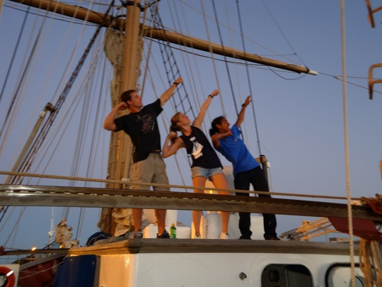
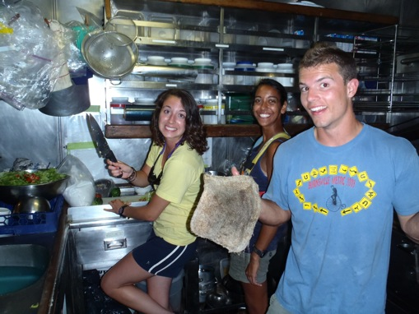
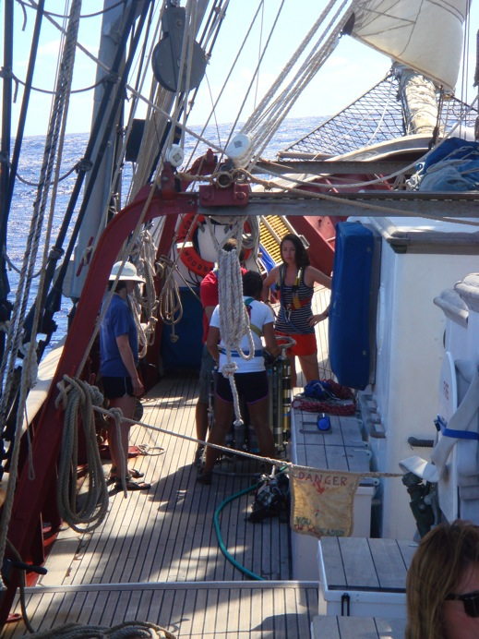
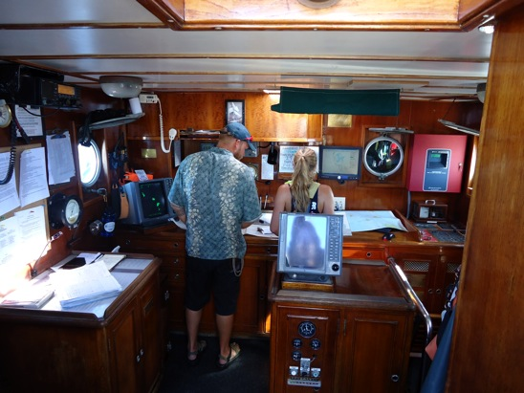
Decision Making Model
SHADOWING – participative
JWO
Steward - colsultation
JLO

Slide 9
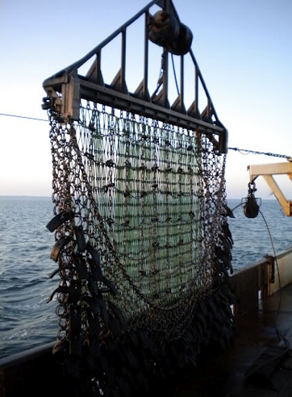


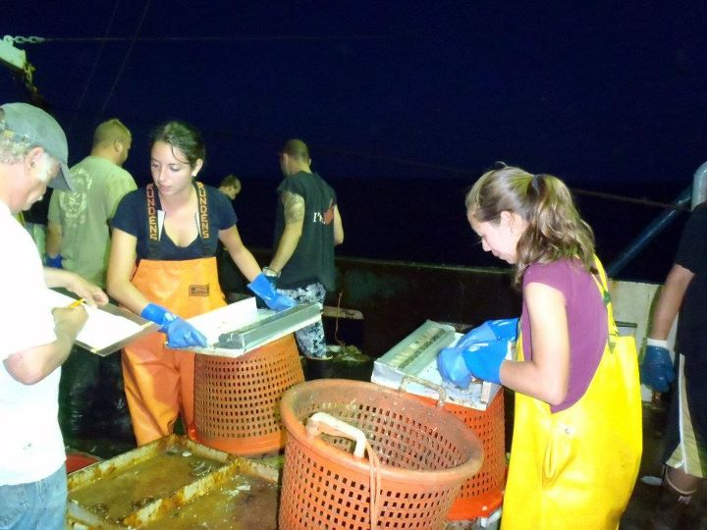
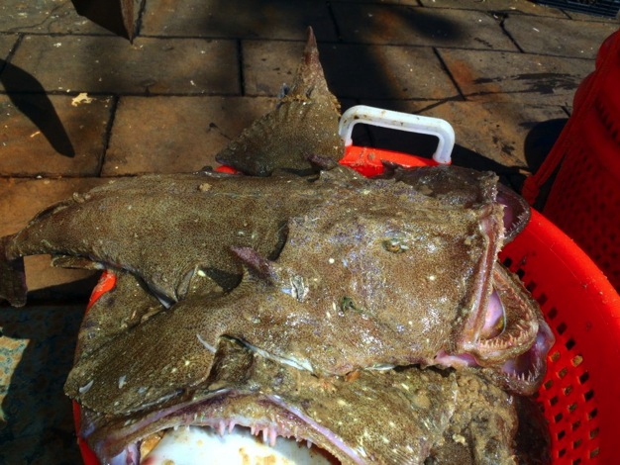
Notes:
107. Student will describe personal examples of preparing for and being interviewed

Slide 10
Starfish
Cove

Slide 11


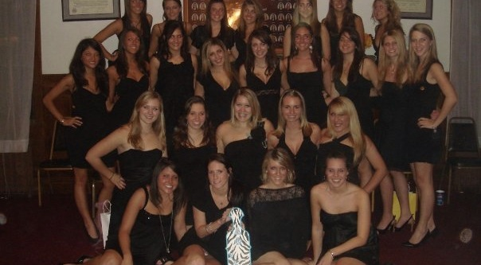

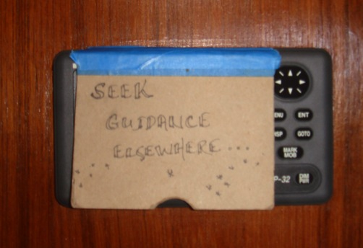
Fall 2008 – The Taus
Fall 2008 new member
Panhellenic Delegate
Director of Administration
ELI 2009 Attendee
President
Regional Conference
International Conference, Miami

Slide 12
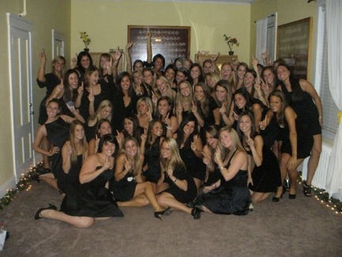
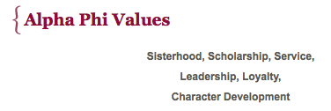
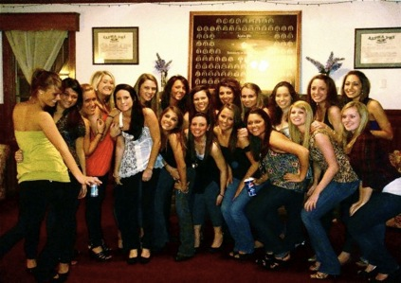

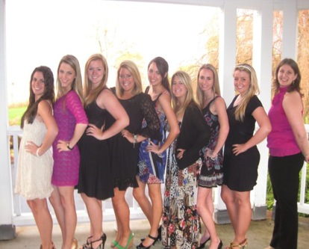
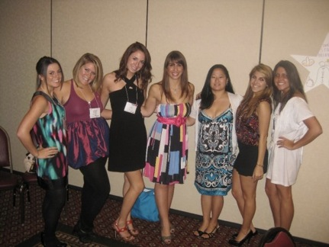

Relational Leadership Model
Knowing, Being, Doing
Inclusive – including all members, being open and accepting to their points of view
Empowering - ; empowering one’s self, and all others involved including the group, to challenge themselves and take on leadership roles.
Purposeful – commitment to the group and all others involved
Ethical – having values that drive the leader
Process-oriented – keep the group on task to keep them as a strong team
Notes:
Relational leadership is putting the relationships with other people first.
five processes of relationship building, which are being inclusive, empowering, purposeful, ethical, and process-oriented.
Inclusive; including all of the members and being open and accepting of their points of view.
Empowering; empowering one’s self, and all others involved including the group, to challenge themselves and take on leadership roles.
Purposeful; having an individual commitment to the group, job tasks, and all others involved.
Ethical; having values and “good” standards of leadership which drive the leader.
Process-oriented; how the leader keeps the group on task and remains a strong team so that they accomplish the goal. Each of these five areas are broken up into three leadership components of knowing (having knowledge and understanding), being (believing that or in the group or cause), and doing (the skills which are utilized).
The relational leadership model focuses on the importance of relationships among the members of a group while they are working together to complete a task.

Slide 13
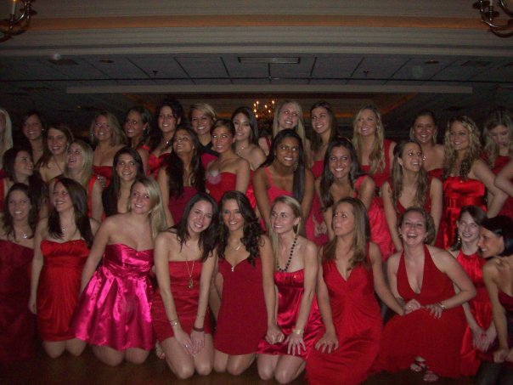
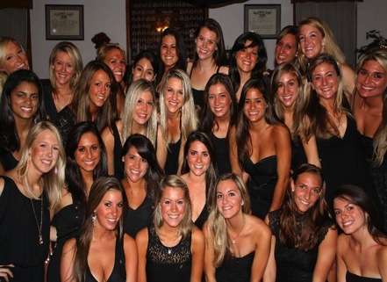
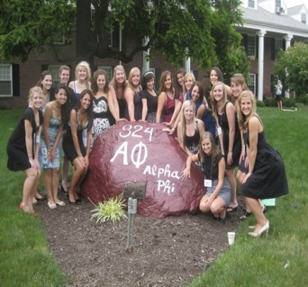
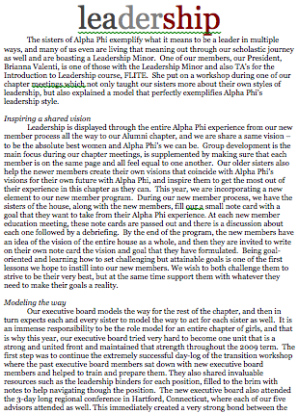
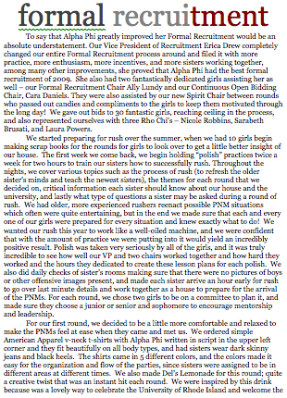
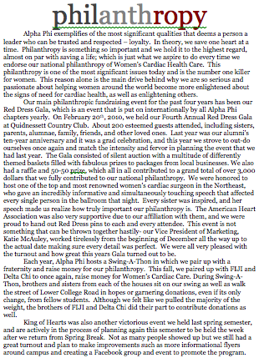
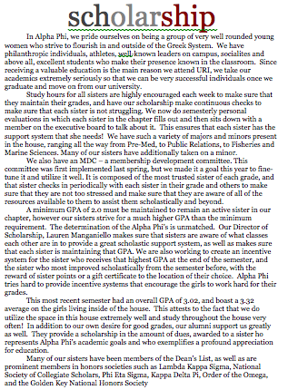
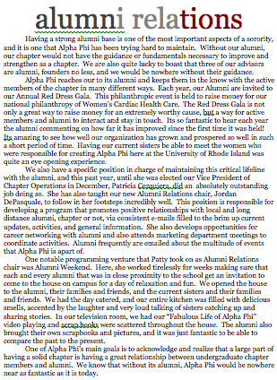
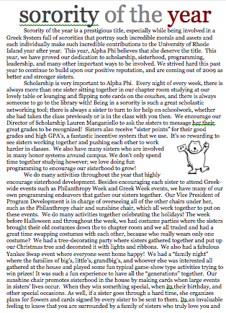
Never tell people how to do things. Tell them what to do and they will surprise you with their ingenuity.
-- George Patton
Notes:
37.Student will show knowledge of the “Situational Leadership” theory by Hershey & Blanchard →RDG
94. Student will show knowledge of the stages of group development (Tuckman), and be able to define / describe teambuilding, group maintenance, and closure in groups → ELI Experience!

Slide 14
St. Rocks

Slide 15
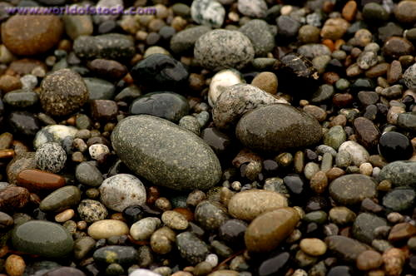
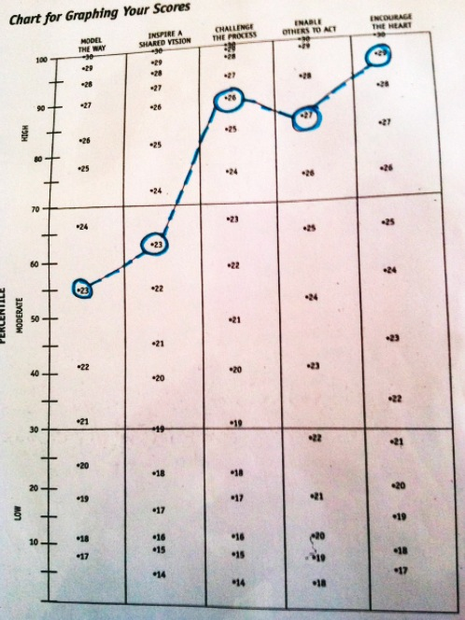
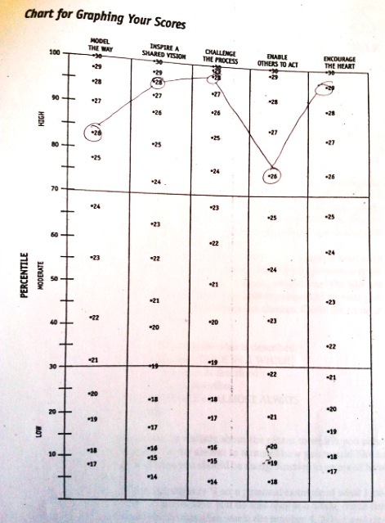
Leadership Practice Inventory
Beginning of Spring, End of Spring,
Freshman year Sophomore Year

Slide 16
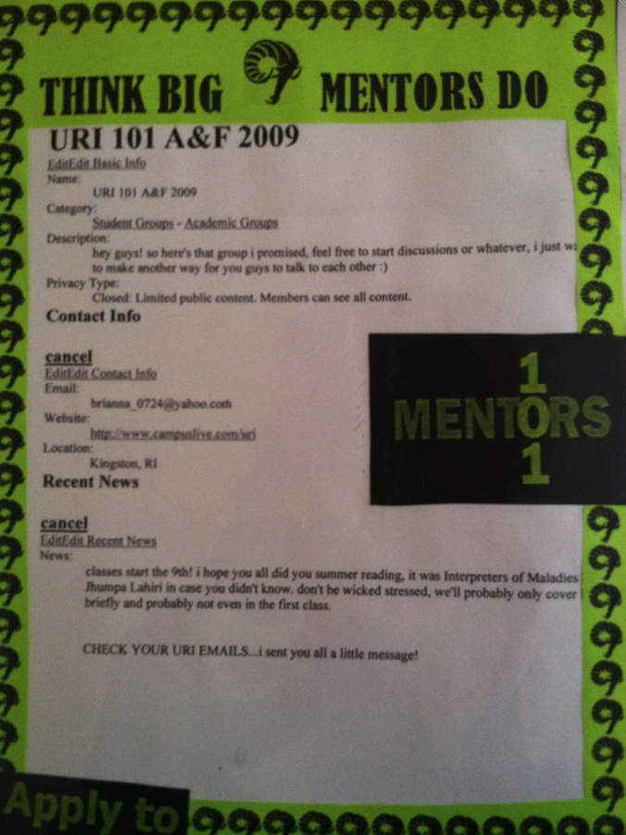
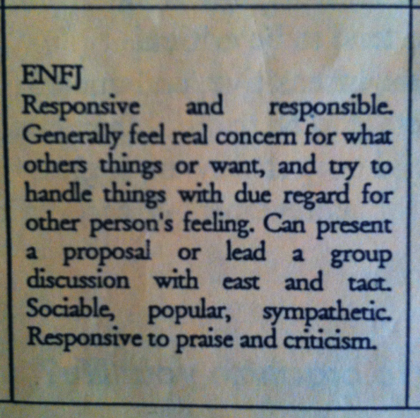
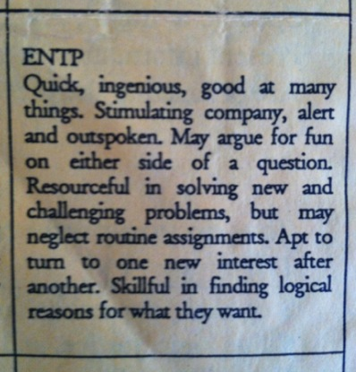
TypeFocus,
then and Now…
Notes:
Extrovert Extrovert
iNtuitive iNtuitive
Thinking Feeling
Percieving Judging

Slide 17
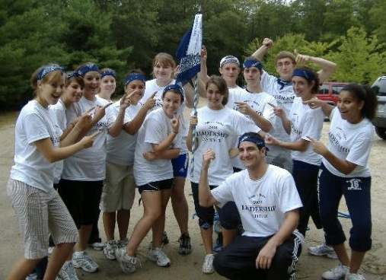
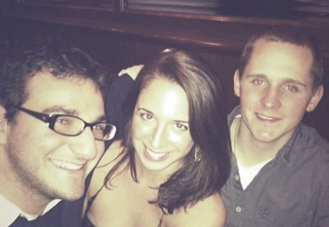





From the beginning
…
to the end

Slide 18

Seagrass
Island

Slide 19






Notes:
90.Student will describe personal examples of organizing meetings / setting agendas / leading meetings
102. Student will show knowledge of the construction / elements of informative and persuasive speeches

Slide 20





Forming
Storming
Tuckmans
Model of
Group Development
Adjorning
Norming
Performing

Slide 21
Sandy Beach

Slide 22






Slide 23


“You have brains in your head. You have feet in your shoes. You can steer yourself any direction you choose. You're on your own. And you know what you know. And YOU are the one who'll decide where to go...”

